Slide 1
RESEARCH

Slide 2
MEANING AND DEFINATION
Research comprises of two words, "Re" and "search". While "Re" implies a repetitive or iterative process, "Search" denotes, making a thorough examination of or looking over carefully in order to find something. Different researchers have defined research in various ways due to its wide scope. But, in general, research can be defined as a scientific process where new facts, ideas, and theories are established and/or proved in different areas of knowledge. Research aims at adding to the existing stock of knowledge for the betterment of world.

Slide 3
Definition of Research According to Waltz and Bausell : "Research is a systematic, formal, rigorous and precise process employed to gain solutions to problems or to discover and interpret new facts and relationships." According to Clifford Woody : "Research comprises defining and redefining problems, formulating hypothesis or suggested solutions, Collecting, Organizing and Evaluating data, Making deductions and reaching Conclusions to determine they fit the formulating hypothesis." According to John Best : "Research is a systematic activity directed towards discovery and the development of an organised body of knowledge."

Slide 4
OBJECTIVE
The objectives of research can vary depending on the field, the specific research topic, and the researcher's goals. However, some common objectives of research include:
To explore and understand a specific topic or phenomenon: Research aims to investigate and gain knowledge about a particular subject, often by examining existing literature, conducting experiments, or collecting and analyzing data.
To advance knowledge: Research seeks to contribute to the existing body of knowledge in a specific field or discipline. It aims to generate new insights, theories, models, or frameworks that can enhance understanding or address gaps in current knowledge.
To solve a problem or address a research question: Research often aims to find answers to specific questions or solve practical problems. It involves formulating research questions or hypotheses and designing studies or experiments to gather relevant data that can inform solutions or provide evidence-based recommendations.
To test or validate existing theories or hypotheses: Research may aim to test the validity or applicability of existing theories, concepts, or hypotheses. It involves empirical investigation, data collection, and analysis to assess whether the observed results support or contradict established theories.
To develop new methodologies or techniques: Research can aim to develop innovative methodologies, tools, or techniques that can improve the process of investigation, data collection, analysis, or interpretation in a particular field. This objective often involves evaluating and refining existing methods or devising new approaches to address research challenges.
To make informed decisions or policy recommendations: Research can provide evidence and insights to guide decision-making processes in various domains, such as public policy, healthcare, business, or education. The objective is to produce reliable and relevant data that can inform policymakers, practitioners, or stakeholders in making informed choices or formulating effective strategies.
To contribute to societal or human knowledge: Research can have broader objectives, such as contributing to the betterment of society, improving human well-being, or addressing social issues. This objective often aligns with applied research or research with a social impact, where the aim is to produce knowledge that can lead to positive changes or advancements in society.

Slide 5
NATURE AND CHARACTERISTICS OF RESEARCH
Systematic: Research follows a systematic and organized approach. It involves carefully planning and designing the study, specifying research objectives and questions, selecting appropriate methods and tools, collecting and analyzing data, and drawing conclusions based on evidence. Systematic research ensures reliability, validity, and replicability of the findings.
Empirical: Research is empirical in nature, meaning it relies on evidence derived from observation, experimentation, or data collection. It involves gathering data from real-world phenomena or situations and subjecting it to systematic analysis. Empirical research aims to generate knowledge based on observable and measurable evidence.
Objective: Research aims to be objective and unbiased. It seeks to discover and report findings based on evidence rather than personal opinions or preferences. Researchers strive to minimize subjective biases by employing rigorous methods, using standardized procedures, and maintaining transparency in data collection, analysis, and interpretation.
Exploratory and Investigative: Research is exploratory and investigative in nature. It aims to explore, understand, and explain phenomena, relationships, or problems. Researchers seek to fill gaps in knowledge, test hypotheses, discover new insights, or uncover hidden patterns. Research helps generate new ideas and theories or refine existing ones.
Analytical: Research involves analytical thinking and critical reasoning. Researchers analyze data, identify patterns, and interpret findings to draw meaningful conclusions. They use various analytical techniques, statistical methods, or qualitative approaches to make sense of the collected data. Analytical skills are crucial for drawing valid inferences and making reliable claims.
Cumulative: Research is cumulative in nature, building upon existing knowledge and contributing to the body of knowledge in a particular field. Research findings become part of the collective understanding, shaping future research and providing a foundation for further investigations. New research often references and builds upon prior studies, leading to an ongoing progression of knowledge.

Slide 6
IMPORTANCE OF RERSEARCH
Research plays a crucial role in various aspects of society and across different fields of study. Here are some key reasons highlighting the importance of research:
Advancing Knowledge: Research is essential for expanding knowledge and understanding in all disciplines. It contributes to the development of theories, concepts, and models, and helps refine existing knowledge. By investigating new areas and addressing unanswered questions, research drives intellectual growth and progress.
Problem Solving and Innovation: Research is instrumental in identifying and solving problems. It provides a systematic approach to investigate and find solutions to challenges faced in various domains, such as medicine, technology, education, and social issues. Research fosters innovation by generating new ideas, methods, and technologies that can lead to advancements and improvements.
Evidence-Based Decision Making: Research produces reliable and credible evidence that informs decision-making processes. Policymakers, professionals, and practitioners rely on research findings to make informed choices and formulate effective strategies. Evidence-based decision making helps improve outcomes and ensures resources are utilized efficiently.
Improving Human Lives: Research contributes to improving human lives by addressing societal needs and challenges. It leads to the development of new medicines, treatments, and therapies in healthcare. It informs policies and interventions for social issues like poverty, inequality, and environmental sustainability. Research drives advancements in technology, engineering, and other fields that enhance quality of life.
Enhancing Education: Research is fundamental to the progress of education. It drives improvements in teaching methodologies, curriculum development, and educational policies. Research in education provides insights into effective learning strategies, factors influencing academic achievement, and the impact of educational interventions.
Economic Growth and Development: Research plays a vital role in economic growth and development. It fosters innovation, entrepreneurship, and productivity. Research provides insights into market trends, consumer behavior, and business strategies, supporting economic decision making. It also contributes to the development of industries, drives technological advancements, and creates employment opportunities.

Slide 7
CHARACTERISTICS OF GOOD RESEARCH
Clearly defined objectives: Good research clearly outlines its objectives, specifying the purpose and focus of the study. The research objectives should be specific, measurable, achievable, relevant, and time-bound (SMART), providing a clear direction for the research.
Rigorous methodology: Good research employs a rigorous and appropriate methodology. The research design, sampling methods, data collection procedures, and analysis techniques should be well-planned and aligned with the research objectives. A strong methodology ensures the reliability and validity of the findings.
Valid and reliable data: Good research relies on valid and reliable data. The data collection process should be systematic, using appropriate instruments or tools. Researchers should employ reliable measurement techniques and ensure the accuracy, consistency, and representativeness of the collected data.
Critical analysis and interpretation: Good research involves critical analysis and interpretation of the data. Researchers should employ appropriate statistical or qualitative analysis techniques to draw meaningful conclusions. The interpretation should be unbiased, objective, and supported by evidence from the data.
Ethical considerations: Good research adheres to ethical principles and guidelines. Researchers should prioritize the protection of participants' rights, ensure informed consent, maintain confidentiality, and handle data responsibly. Ethical research practices build trust and credibility in the research community.

Slide 8
Contribution to knowledge: Good research contributes to the existing body of knowledge in the field. It addresses a research gap, provides new insights, or challenges existing theories. The research should generate knowledge that is relevant, meaningful, and can be applied or built upon by other researchers. Clear and coherent reporting: Good research is effectively communicated through clear and coherent reporting. The research findings, methodology, analysis, and conclusions should be presented in a logical and organized manner. The research report or publication should adhere to standard formatting and citation guidelines. Replicability and generalizability: Good research should be replicable and generalizable to some extent. Sufficient information about the research design, methodology, and data should be provided to allow other researchers to replicate the study. The findings should have relevance beyond the specific study context and be applicable to a broader population or situation. Openness to scrutiny and feedback: Good research welcomes scrutiny and feedback from the research community. Researchers should be open to constructive criticism, peer review, and collaboration. Engaging in discussions and debates strengthens the quality and impact of the research. Continuous improvement and learning: Good research is characterized by a commitment to continuous improvement and learning. Researchers should reflect on their research process, identify areas for improvement, and incorporate feedback into future studies. The research should contribute to personal growth and the advancement of research practices. By embodying these characteristics, good research ensures the production of reliable, valid, and impactful knowledge that contributes to the advancement of the field

Slide 9
RESEARCH METHOED Vs METHODOLOGY
RESEARCH METHOED
RESEARCH METHODOLOGY
Research Method:
A research method refers to the specific techniques, tools, or procedures employed by researchers to gather data, analyze information, and answer research questions or test hypotheses. It involves the practical steps taken to conduct research. Examples of research methods include surveys, experiments, interviews, case studies, observations, and literature reviews. Each research method has its own strengths, limitations, and suitability for different research objectives.
Research Methodology:
Research methodology refers to the overall approach or framework that guides the entire research process, including the choice and application of research methods. It encompasses the theoretical underpinnings, principles, and procedures followed by researchers to design and conduct their studies. Research methodology involves decisions regarding the research design, sampling techniques, data collection and analysis methods, and the interpretation and presentation of findings. It provides a systematic plan for conducting research and ensures that the study is valid, reliable, and rigorous.

Slide 10
TYPES OF RESEARCH

Slide 11
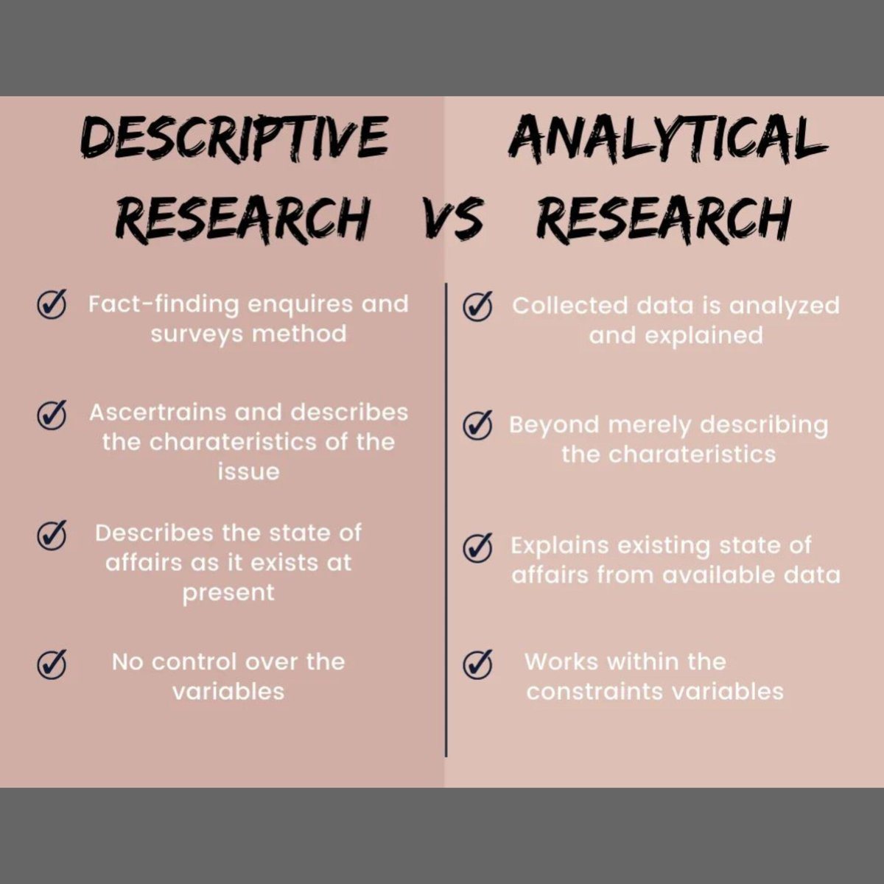

Slide 12
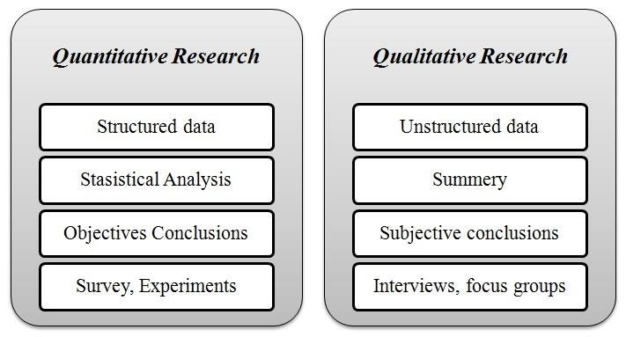

Slide 13
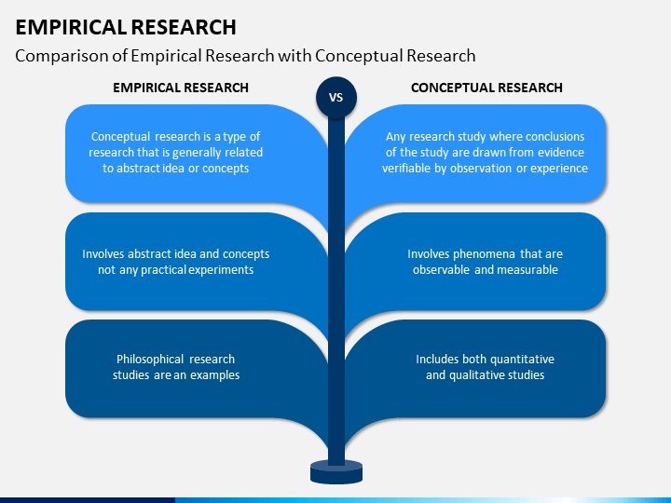

Slide 14
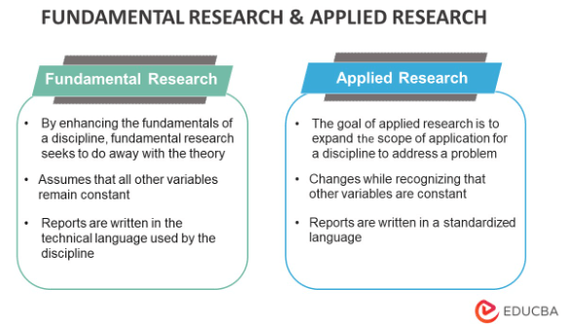

Slide 15
THANK YOU.........
SUBMITTED BY :-
ASHIMA SHARMA
DEPT. OF CHEMISTRY

